Slide 1
SECURE DATA HIDING IN IMAGES USING STEGANAGRAPHY
CAPSTONE PROJECT
Presented By: BHOOMIKA .R
Student Name : BHOOMIKA.R
College Name :CHANNABASAVESHWARA INSTITUTE OF TECHNOLOGY,GUBBI
Department: COMPUTER SCIENCE AND ENGINERING

Slide 2
Problem Statement
Develop a secure data-hiding technique using steganography to embed confidential information within digital images while ensuring minimal perceptual distortion and resistance to unauthorized extraction. The solution should focus on enhancing data security, maintaining image quality, and preventing detection by steganalysis methods.

Slide 3
Technology used
Programming Languages: Python
Steganography Techniques: LSB (Least Significant Bit), DCT (Discrete Cosine Transform), DWT (Discrete Wavelet Transform)
Cryptography: AES (Advanced Encryption Standard) for added security
Image Processing Libraries: OpenCV, PIL (Python Imaging Library)
Compression Algorithms : JPEG Compression
Platform : Windows11

Slide 4
Wow factors
Robust Extraction & Error Handling
Even if the image is slightly modified (cropping, compression), error correction techniques ensure accurate data retrieval.
Remote Access & Cloud Storage Integration
Allows secure cloud-based storage and retrieval of stego-images with hidden data, ensuring accessibility from anywhere
Minimal Image Distortion
Uses adaptive encoding techniques to ensure high-quality images after embedding, making changes imperceptible to the human eye.
High Capacity Data Hiding
Optimized algorithms allow embedding more data without significantly affecting image quality, making it superior to traditional methods.

Slide 5
End users
Cybersecurity Professionals & Ethical Hackers
Use steganography for secure communication and data protection in high-risk environments.
🕵️ Government & Intelligence Agencies
Securely transmit classified information without detection.
📡 Journalists & Whistleblowers
Hide sensitive documents or messages in images to avoid censorship and government surveillance.
🛡️ Military & Defense Organizations
Use steganography to secure military communication and prevent data interception.
💼 Corporate Sector & Businesses
Protect confidential business data, trade secrets, and sensitive client information from cyber threats.

Slide 6
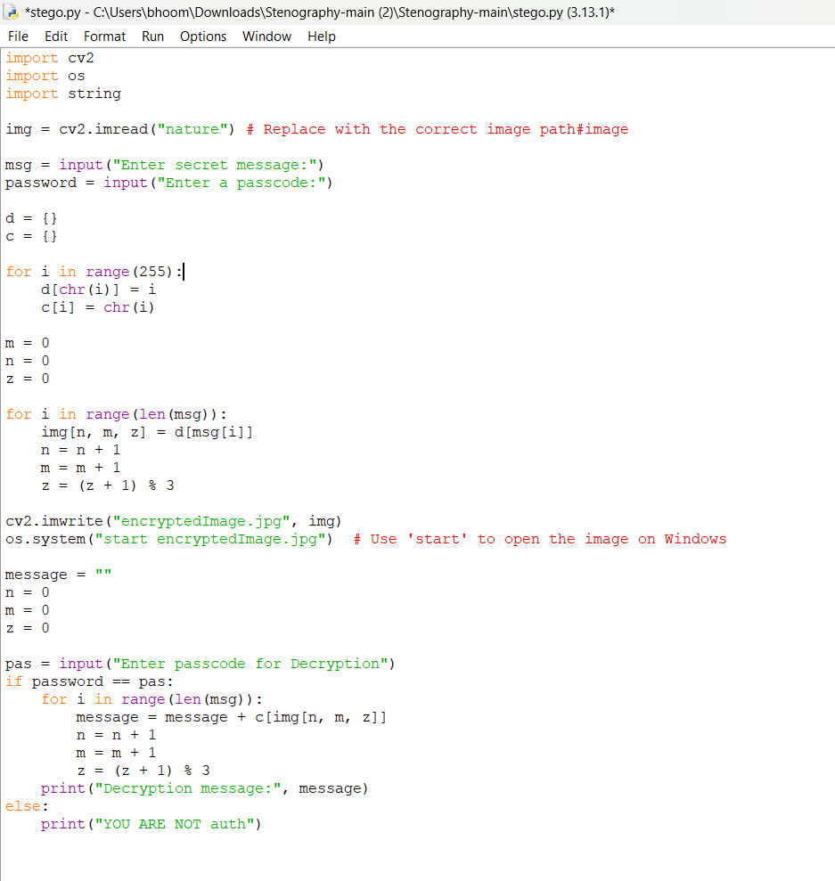
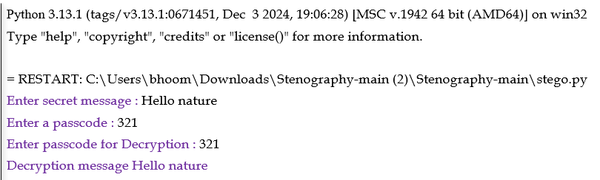
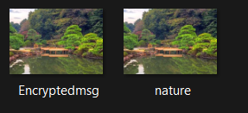
Results

Slide 7
Conclusion
This project successfully addresses the challenge of secure data hiding in images using steganography by implementing advanced encoding techniques that ensure confidentiality, minimal image distortion, and resistance to detection. By integrating encryption (AES) and multiple steganographic methods (LSB, DCT, DWT), the solution enhances security while maintaining high image quality.
The project stands out due to its high-capacity data embedding, cross-platform compatibility, and potential AI-powered optimizations. It provides a robust and efficient method for secure communication, catering to end-users such as cybersecurity professionals, government agencies, businesses, and privacy-conscious individuals.
In conclusion, this system offers a practical, secure, and innovative approach to modern steganography, making it an essential tool for covert communication and data protection in today's digital world

Slide 8
GitHub Link
https://github.com/bhoomikar386/my-_1_git-project.git

Slide 9
Future scope
Blockchain and Cryptography Integration
Secure Transactions: Embedding transactional details within blockchain records for additional security. Enhanced Encryption: Combining cryptography and steganography for double-layer security in data transmission.
Artificial Intelligence and Machine Learning Applications
AI-Powered Steganalysis: Detecting hidden messages in steganographic content using machine learning. Automated Steganographic Techniques: AI-driven methods for more efficient and untraceable data hiding.
Medical and Forensic Applications
Medical Data Security: Concealing patient records within medical images like MRIs or X-rays for privacy. Digital Forensics: Tracing hidden communications in criminal investigations and cybercrime case

Slide 10
THANK YOU

